Slide 2
XGBoost
Boosting is one type of ensemble technique
Xgboost is nothing but extreme gradient boost. It has several advantages over GBM
One of the biggest advantage is inclusion of regularization parameter
Regularization is a process in which we have log loss function and we add regularization term to it (theta).
The goal of regularization is to control the variance of the model
XGBoost is a more advanced and refined version of Gradient Boosting Machines (GBM). While both use boosting algorithms to sequentially train decision trees, XGBoost incorporates regularization, parallel processing, and other optimizations for improved performance and speed. And Xgboost have his own library.
It can take care of missing values

Slide 4
Model Explainibility
Model explainability, also known as explainable AI (XAI), refers to the ability to understand and interpret the decisions and behavior of a machine learning (ML) model
It involves providing clear and understandable explanations for the model's outputs and decision-making processes, fostering trust and accountability
First thing is On What it is working? And then how it is working?
How this regression model is working called explainibility
On what it is working is called Interpretability

Slide 5
Ex, Scenario: Imagine a model used to predict whether a patient is likely to have a specific disease.
Without Explainability: The model might correctly predict a positive outcome (disease present), but without explainability, you wouldn't know which patient features (e.g., age, symptoms, medical history) influenced the prediction.
With Explainability: An explainable model would not only predict "disease present" but also explain the factors contributing to that prediction. For instance, the explanation could reveal that "age over 65" and "history of X disease" were key indicators in this particular case.
In black box you can not explain your model, on the opposite side in white box you can explain it like decision tree is example of white box

Slide 7
LIME (Local Interpretable Model-agnostic Explanations)
LIME is a method for explaining the predictions of machine learning models, particularly those that are difficult to interpret, by approximating their behavior locally with a simpler, more interpretable model.
It works by perturbing the input data to the original model and observing how the predictions change, ultimately providing insights into which features most influence the model's decisions for a specific data point.
Ex, imagine you have a model that predicts whether a customer will click on an ad based on their browsing history. This model is complex and you don't know why it's making predictions. You want to understand why the model predicted that a specific customer would click the ad.
Lime mothod is bit complex theoritical wise
If we have neural network model is basically text classification model.

Slide 8
Like, it passes “India is a great country” we have to check whether it’s whether this is sentiment wise positive statement or negative statement for neural network train model
It’s complex model, it can not give you much explainibility on it’s own.
Generally in Neural network, highly complex model does not help you to understand explainibility
What are the features that are looking for? In Neural network individual word act as a feature
Idle explainability looks like it’s using “great” word so it’s positive statement means great word have higher importance in it
In Neural network when we are passing individual sentence it’s called expected instance and neural network is black box model
We will create more sentence around “India is a great country” in a similar way and it’s called perturbation.
Means you are creating additional data and then we put this data in neural network

Slide 9
It will give output for each sample statement. Neural network is judging the sense of the sentence, it’s not judging the meaning of sentence
Means whether this statement is positive or negative
Now we will train model on this data and that model will be explainable model, explainable model could be anything like decision tree or any linear model
Now this explainable model give us the result like decision tree tell us what each feature is contributing
In sentence, your individual word are feature
This is the basic idea of LIME

Slide 10
K – Nearest Neighbors
The k-Nearest Neighbors (k-NN) algorithm is a simple yet powerful supervised learning method used for both classification and regression.
It works by classifying a new data point based on the majority class of its "k" nearest neighbors in the training data.
The distance between data points is a crucial part of the algorithm, and various distance metrics like Euclidean or Manhattan distance can be used.
KNN is a lazy learner because there is no learning here.
Means no gradient descent nothing only Euclidean distance.
as a dataset grows, KNN becomes increasingly inefficient, compromising overall model performance.
It is commonly used for simple recommendation systems, pattern recognition, data mining, financial market predictions, intrusion detection, and more.

Slide 11
Here, there is no learning happening here. In Learning we have some initial data points, you make mistakes and correct that mistakes
We are doing calculation on Euclidean distance
If K = 5 then it will take majority of 5 nearest points which class is belong to so we are just plotting the data

Slide 13
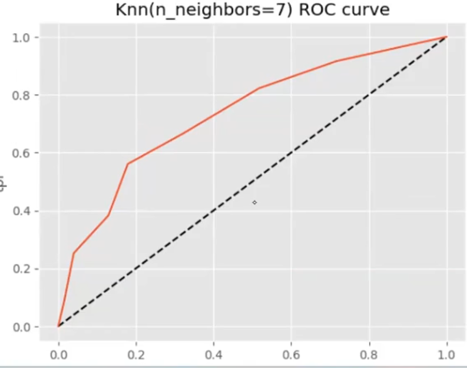
ROC AUC Curve
ROC AUC curve use as an evaluation matrix. You have confusion matrix and you can find false positive and true positive rate and then you pass threshold like in logistic we have threshold of 0.5 it can vary
I will changing my threshold and plot the curve
Black line is 50% line as you move away to black line threshold and accuracy will be increasing

Slide 14
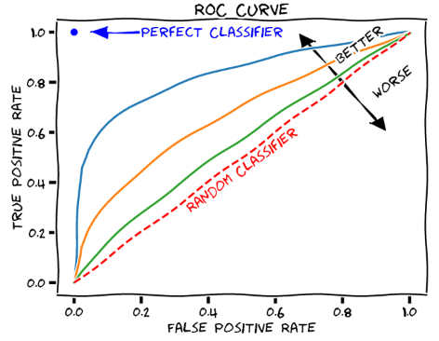
The Receiver Operating Characteristic (ROC) curve and Area Under the Curve (AUC) are essential tools for evaluating the performance of binary classification models.
The ROC curve plots the True Positive Rate (TPR) against the False Positive Rate (FPR) at various classification thresholds.
The AUC represents the model's ability to discriminate between positive and negative classes, with a higher AUC indicating better performance.

